Slide 1
Python Project
FIFA 19 ANALYSIS
Arpit Agarwal
Avi Manawat
Puneet Kochar

Slide 2
Objective
Build a dream team through analysis of data
Estimated Wage of new player according to his skill
Total Champions leagues and total trophies won by various team
Detail analysis of players
Analysis of the wage of players by data visualization through various factor
Which club has high worth players

Slide 3
Data Source
https://www.kaggle.com

Slide 4
Packages used:
Numpy
Pandas
Urllib
Matplotlib
Seaborn
Datetime
Sci-Kit
Scipy
Re

Slide 5
Data Filtering and Cleaning:
Read the dataset into python using Pandas package
We selected columns that we wanted to use for our analysis.
Since, we are interested in player position. We set that column as our base.
We removed null value in the column team position.
Then we removed ‘Reserved’ and ‘Substitute’ player, as our primary focus is on playing team.
Finally, we separated the data set into 2 data frame of Goalkeeper and Other Players, because the have different skill set.

Slide 6
Data Scraping:
We used the link https://www.90min.com/posts/6244570-10-football-clubs-who-have-won-the-most-trophies-from-europe-s-top-5-leagues for scraping data of top clubs, who won most total trophies and total champions league trophies.
Using Urllib3 package, we found the patterns of team name through HTML and generated the results.
Used Matplotlib package to visualize the data of top clubs with most total trophies and champions league
Club to win maximum Total Trophies : Barcelona
Club to win Champions League maximum times : Real Madrid

Slide 7
Data Visualization
In order to properly visualize the data, we selected a random sample data from original data set with sample size 500.
Using seaborn package, plotted linear model plot to analyze relationship between Overall Rating and Wages of Players.
Plotted box to analyze the distribution of wages among the players.
Plotted correlation Heatmap to find correlation between each column of data.

Slide 8
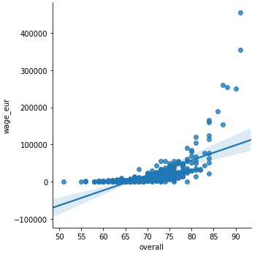
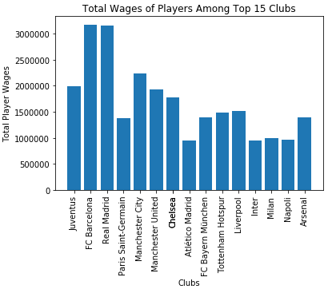
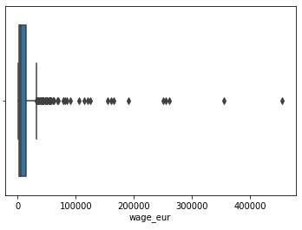
Data Visualization
To analyze the club spending most on wages of players, we used Matplotlib Package.
Plotted Bar chart of Total wages of Players among top 15 clubs.
Analysis: Barcelona spends most on wages of players followed by Real Madrid while the least amount was spent by Atletico Madrid among top 15 clubs.

Slide 9
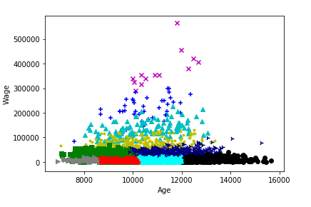
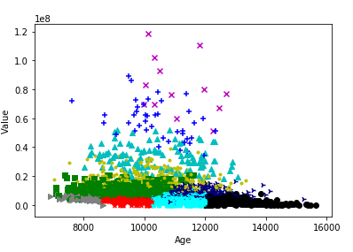
Clustering of data on basis on age
By Wage
By Total worth (million)

Slide 10
Key Insights
Constructed an MLR model by using overall rating and different goalkeeper skills to estimate the wage of the goalkeeper.
Constructed another MLR model using overall rating and different player skills to estimated wage of other players.
Created a function to estimate wage of the player based on customized user inputs.
Predicted best player for each specific position based on his overall rating.
Prepared a user-input function which gives the player summary statistic on entering the player’s name.

Slide 11
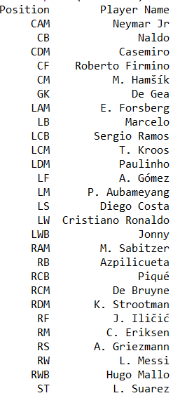
Dream Team

Slide 12
Thank You

